Slide 1
Project Status 1
Arunabh Ghosh

Slide 2

The optimization function
This is the optimization function used in the alternate minimization scheme –
$$\sum_{i=1}^{Q}{{\left\|y_{i}−φ_{θ_{i}+δ}x\right\|}^{2}}+{\left\|{(R}_{δ}{x)}_{i,j} −{(R}_{δ}{x)}_{−i,j}\right\|}^{2}$$
where, $δ$ is such that a rotation of the image by $δ$ in the clockwise direction would set the axis of symmetry of image as horizontal.

Slide 3

Procedure
An initial estimate of the $θ$ and the $δ$ was obtained using the moments based estimate.
After which the optimization problem stated previously is used to iteratively refine these estimates to obtain the final estimate.
The image is refined using a gradient descent approach and the angle and axis of symmetry is refined using a brute-force search.

Slide 4

Experiment
The following will experiments will show the noticeable benefit of including symmetry in out optimization routine as compared to optimizing just the following function –
$$\sum_{i=1}^{Q}{{\left\|y_{i}−φ_{θ_{i}}x\right\|}^{2}}$$
Both the optimization routines will be run on precisely the same initial conditions, the same noise, the same estimate returned by the moment based algorithm. The only thing changing in both the cases is the optimization routine.

Slide 5

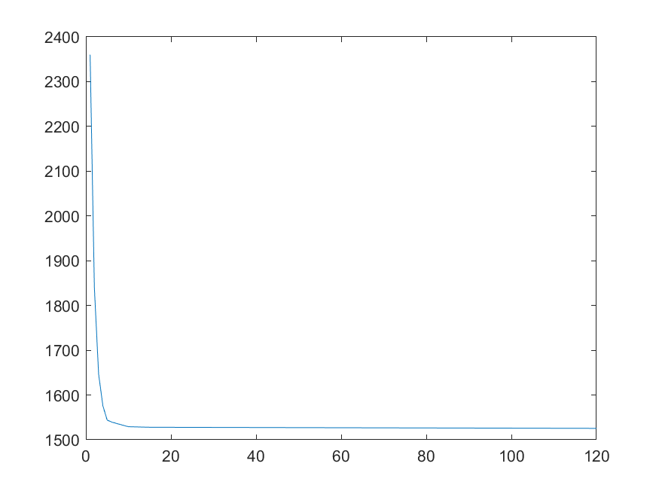

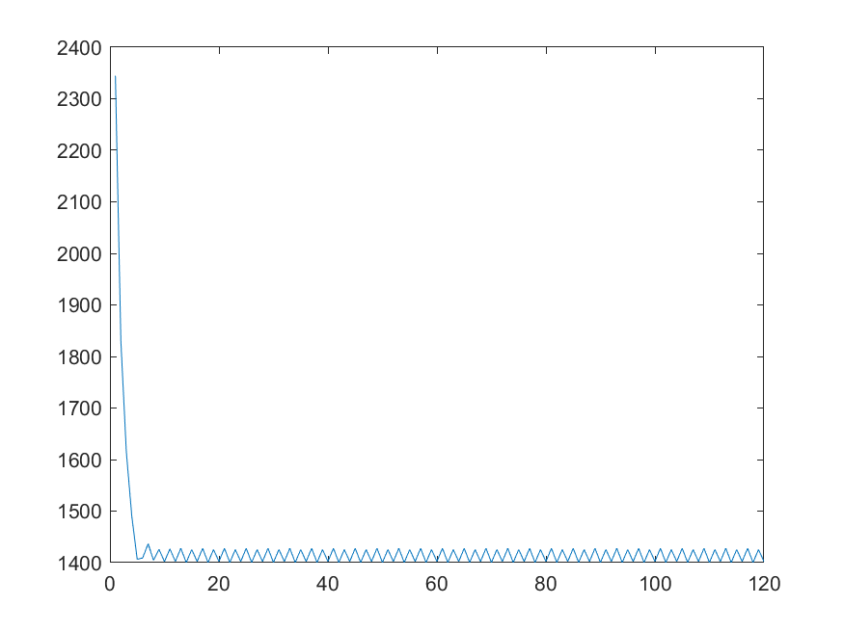

Experiment
Original
Initial conditions:
30 projections
5% Gaussian noise
The above graph denotes the convergence rate without using the symmetry and the graph below is using symmetry.
Using Symmetry
Mean Squared Error
Using Symmetry | 10.16
Without Symmetry | 10.52
Without symmetry

Slide 6
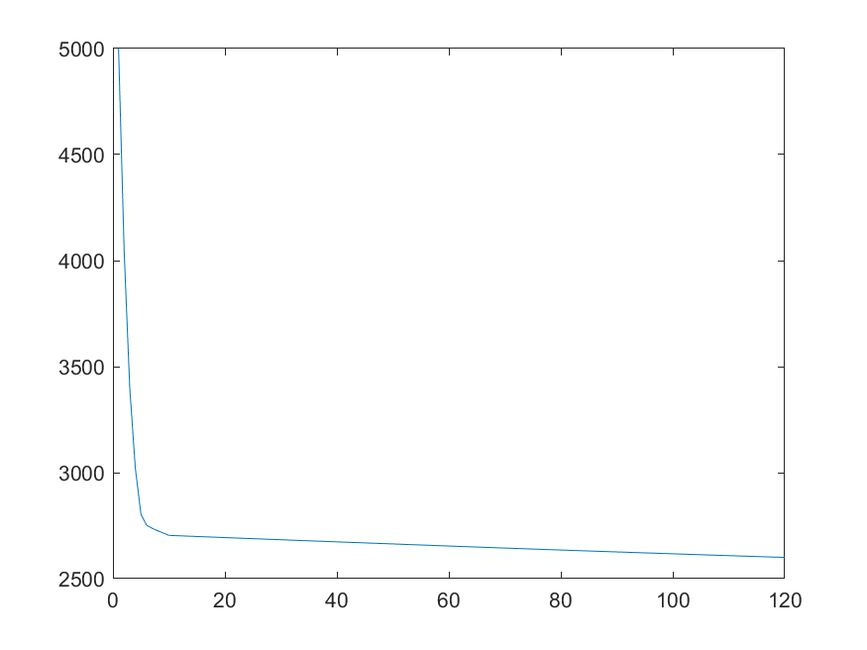

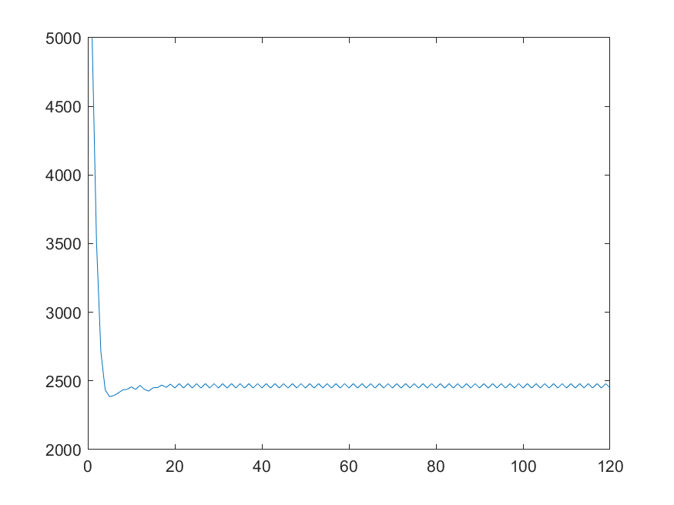

Experiment
Original
Initial conditions:
90 projections
15% Gaussian noise
The above graph denotes the convergence rate without using the symmetry and the graph below is using symmetry.
Using Symmetry
Mean Squared Error
Using Symmetry | 10.36
Without Symmetry | 11.85
Without symmetry

